Slide 1
Top MovieS
202288002 홀랑
WHAT MAKES MOVIES FAMOUS?
Have you ever wondered what makes certain movies unforgettable hits, while others fade into obscurity? Our project dives deep into the data behind movie success, analyzing over 10,000 films to uncover the secrets of fame.
빅데이터처리 기말 발표

Slide 2
Contents
202288002 홀랑
Step1- Data Collection
Step2- Data Cleaning
Step3- Understanding Correllations
Step4- Data Visualazation
Conclution
MOVIES

Slide 3
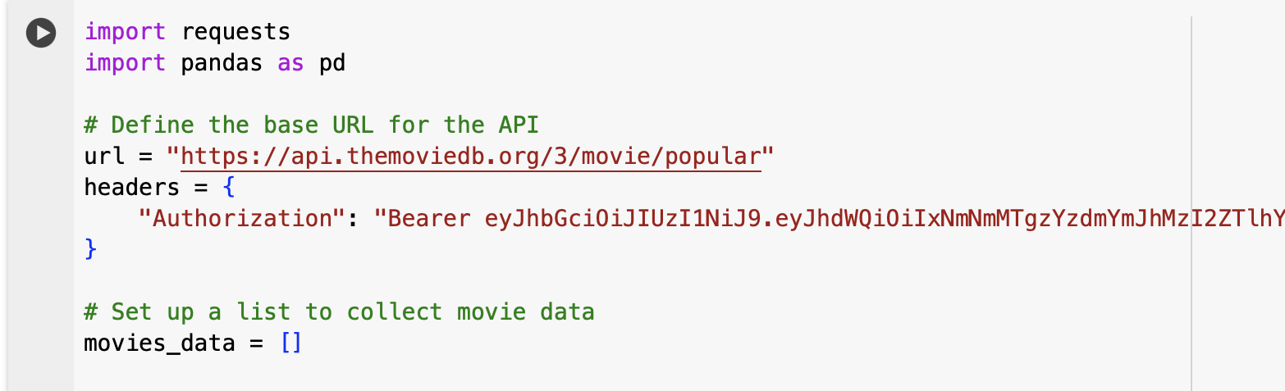
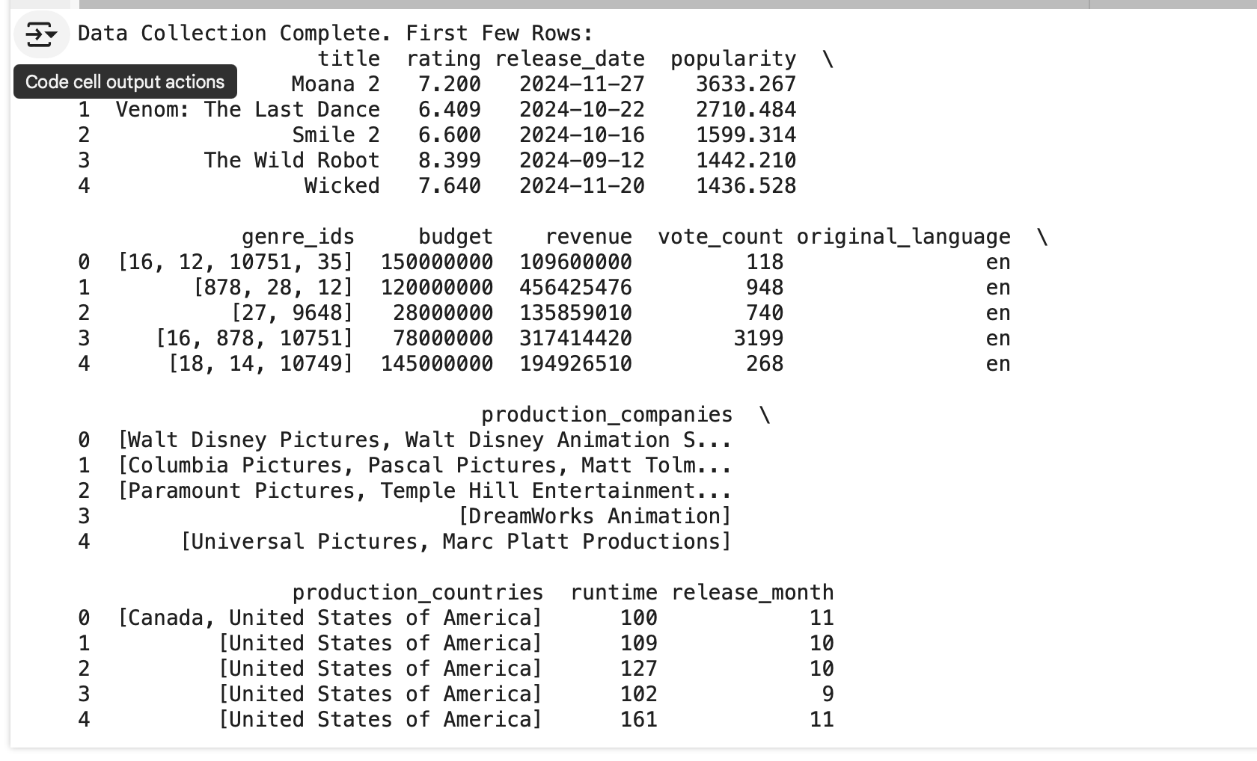
Data Collection
202288002 홀랑
Data Collection: Collected global movie data using the TMDB API (over 10,000 movies in total)

Slide 4
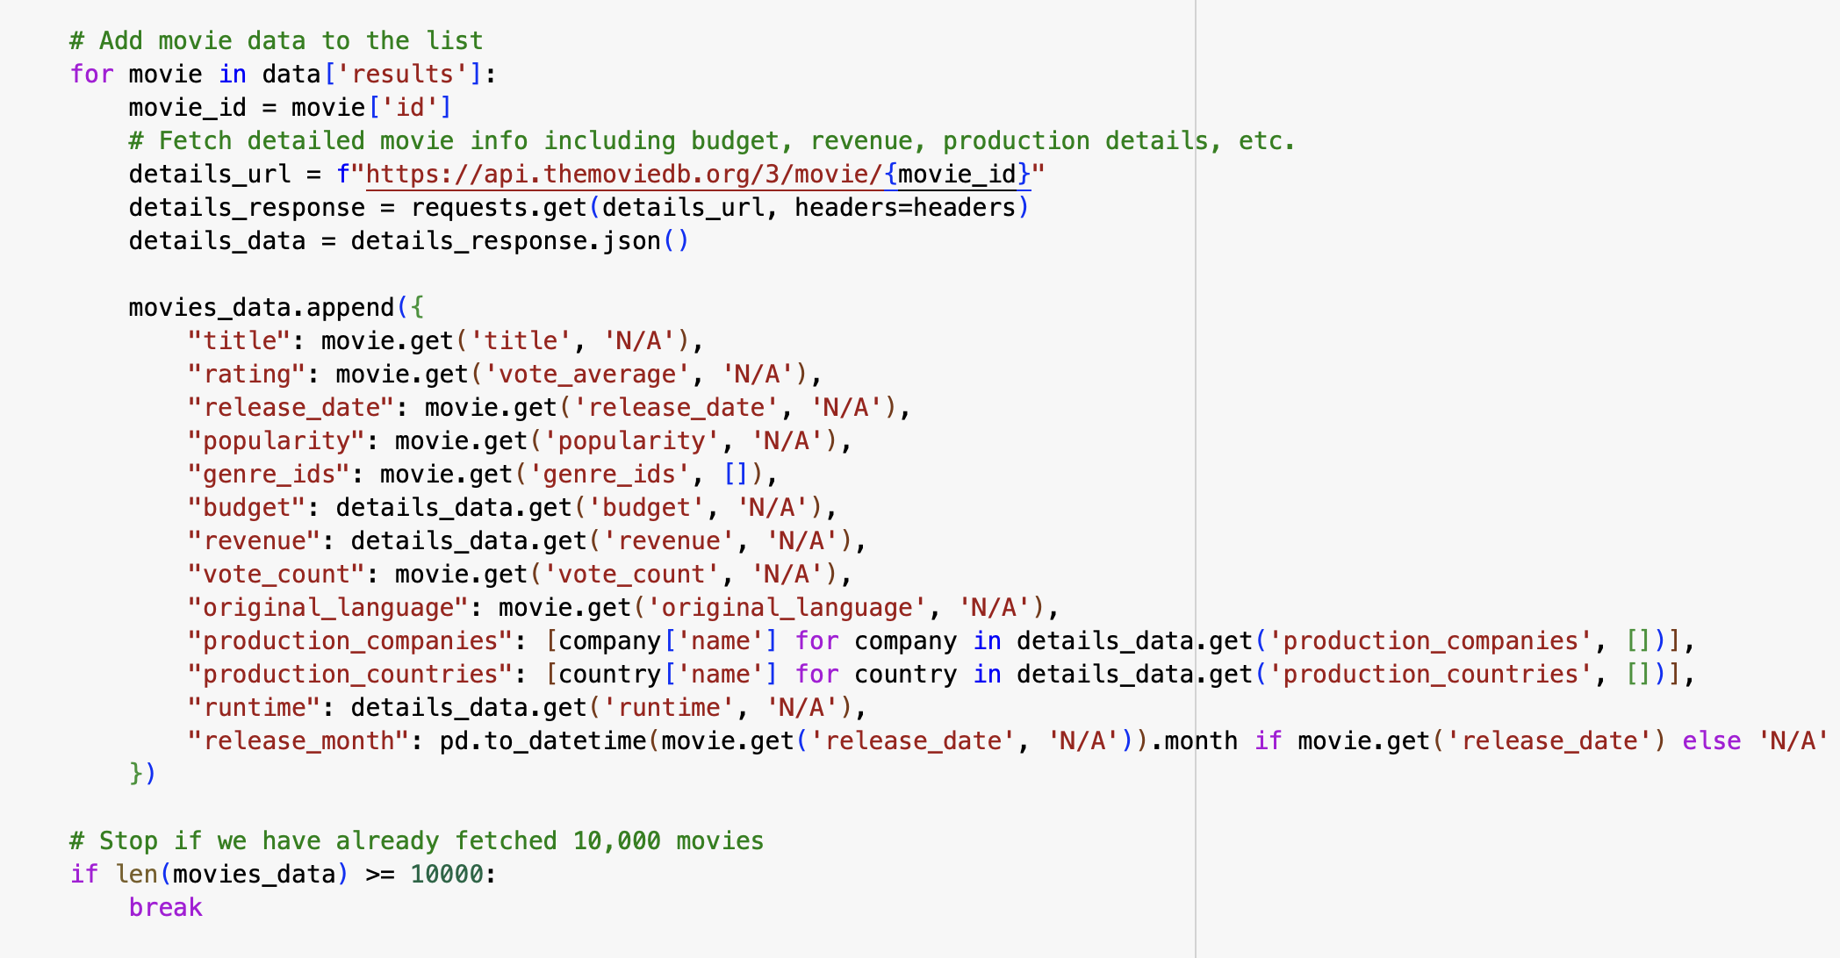
Data Collection
202288002 홀랑
Collected Information: Includes title, release date, popularity score, budget, revenue, director, main cast, production countries, production companies, and more (over 20 columns)
Data Collection Method: Data collected through RESTful API calls using Python

Slide 5
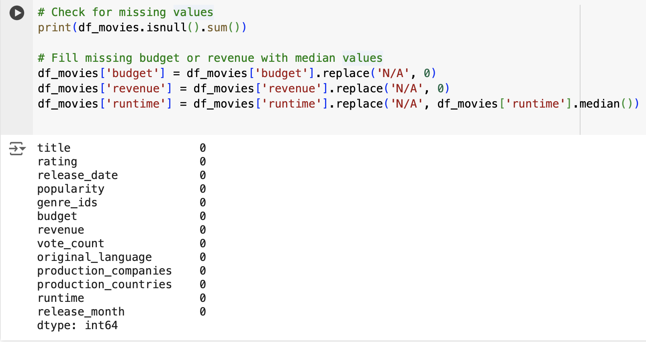
Data cleaning
202288002 홀랑
Handling Missing Values: Replaced some missing values with averages or medians
Removing Duplicate Data: Removed duplicate entries to ensure data accuracy

Slide 6
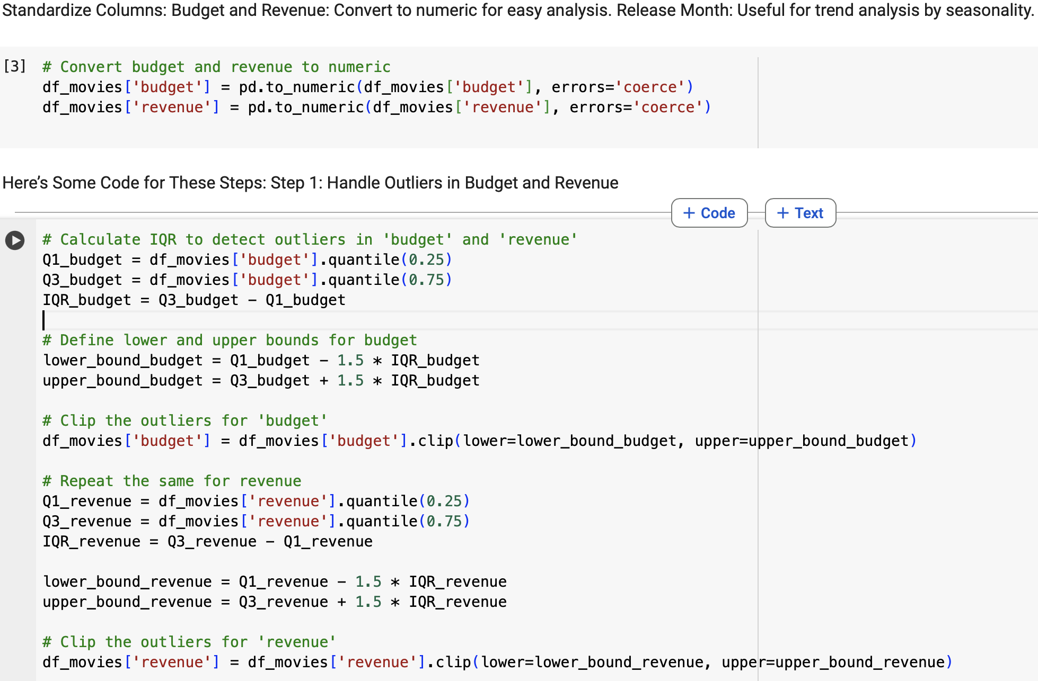
Data cleaning
202288002 홀랑
Standardizing Data Formats: Standardized numeric data, such as budget and revenue, to ensure consistency
Standardize Columns: Budget and Revenue: Convert to numeric for easy analysis. Release Month: Useful for trend analysis by seasonality.

Slide 7
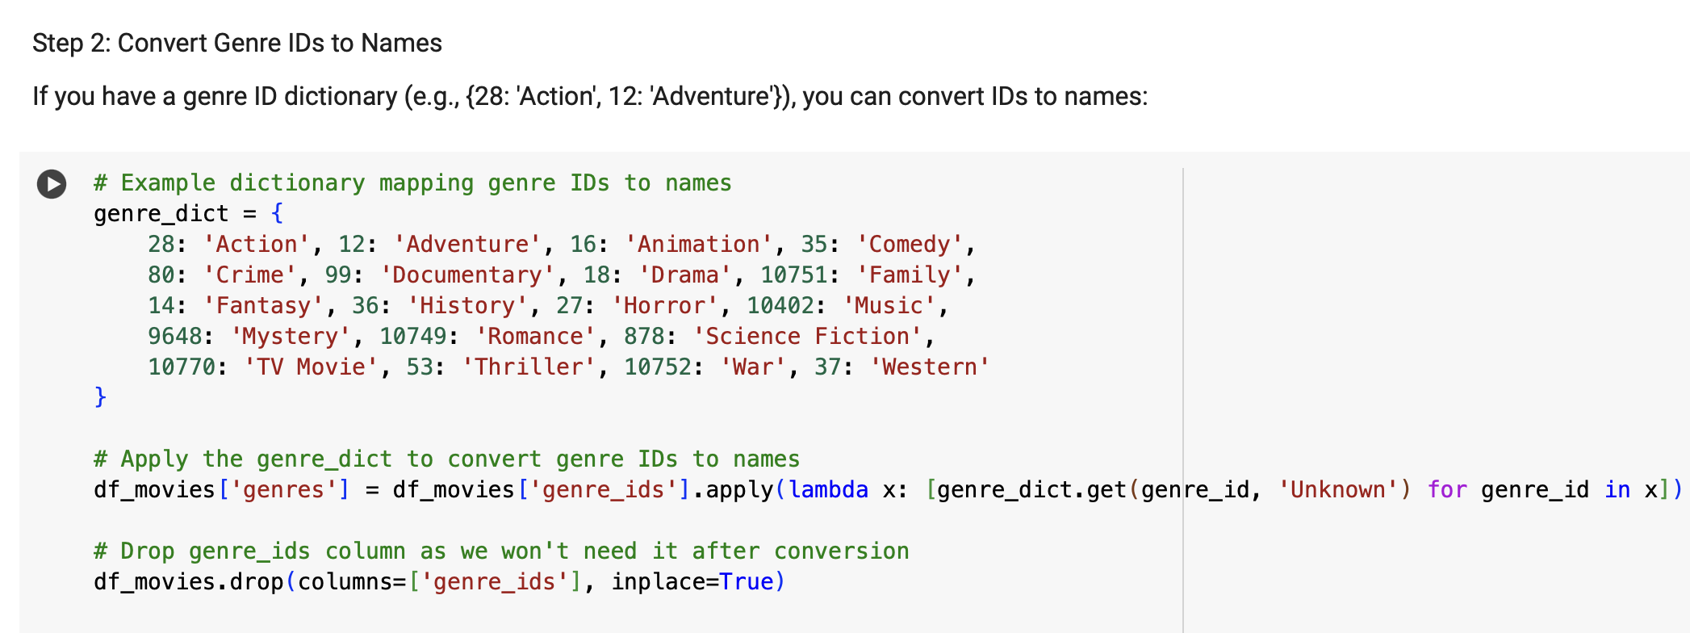
Data cleaning
202288002 홀랑
Data Quality Management:
Standardization: Consistently adjusted date formats and unified budget and revenue units
Identified Issues and Solutions: Identified problems such as missing values in some fields and applied methods to replace them
Convert Genre IDs to Names

Slide 8
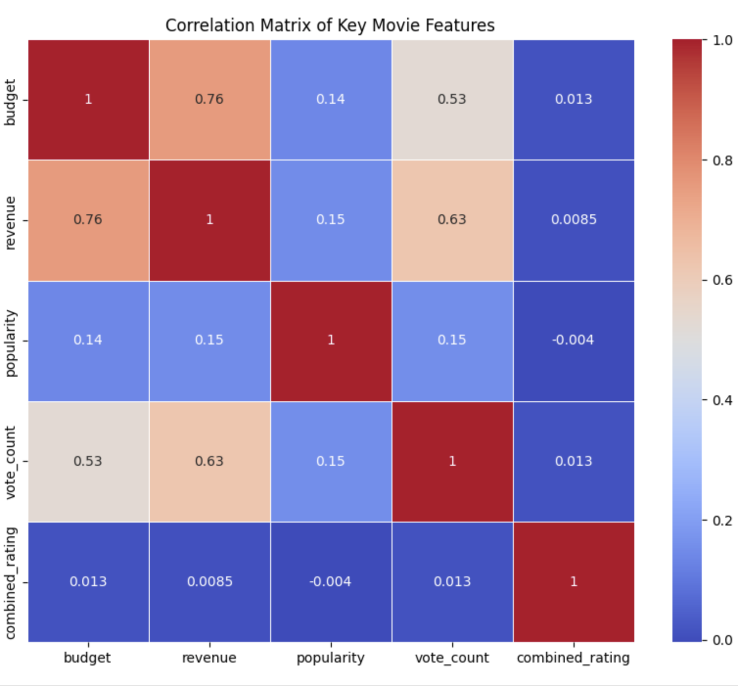
Data visualization
202288002 홀랑
Correlation Matrix: This matrix shows the correlation between different features in your dataset. It will help you determine which factors are highly correlated with revenue or popularity.Heatmap: A heatmap is a great visual tool to quickly understand which features have the strongest relationships with others.

Slide 9
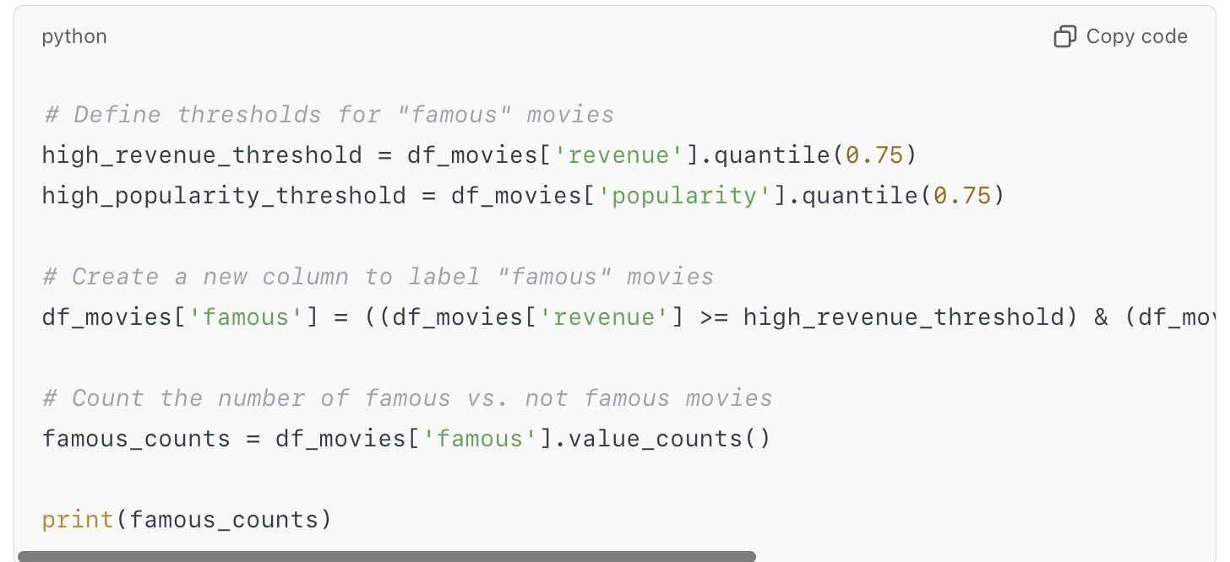
Data visualization
202288002 홀랑
Step 2: Define What Makes a Movie "Famous"
We need to decide how to define a famous movie. Let’s use a combination of:
High Revenue: Top 25% of movies based on revenue.
High Popularity Score: Top 25% based on the popularity score.

Slide 10
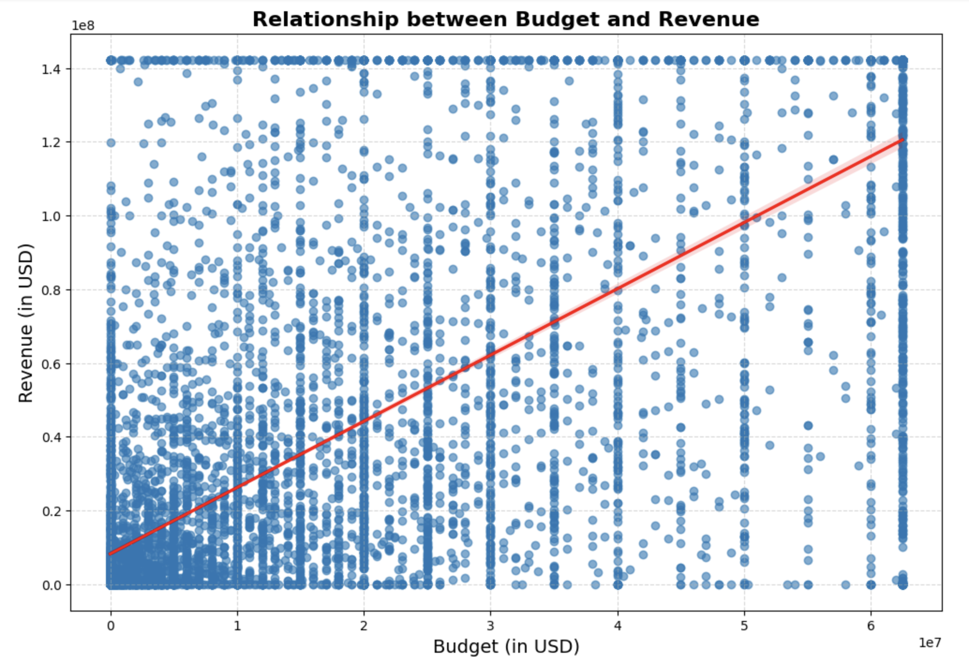
Data visualization
202288002 홀랑
1. Scatter Plot of Budget vs Revenue (with Regression Line)
Since budget and revenue have a strong positive correlation, a scatter plot with a regression line will help visually confirm this trend and illustrate how budget impacts revenue.

Slide 11
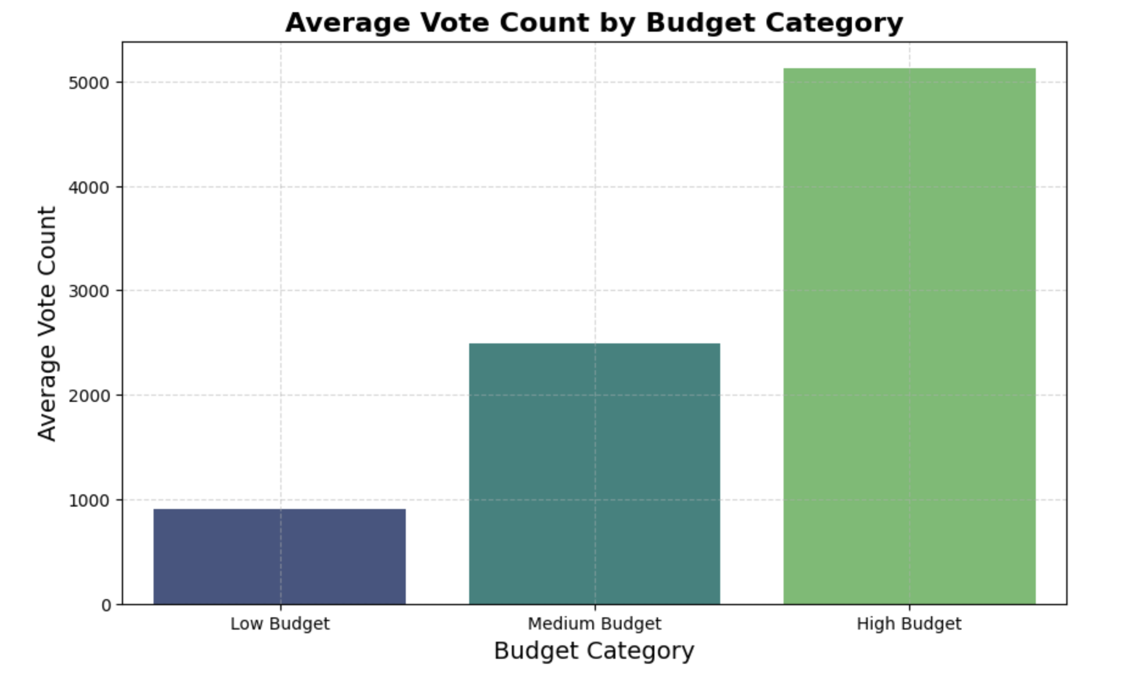
Data visualization
202288002 홀랑
2. Bar Plot: Average Vote Count for Different Budget Categories
Since budget and vote count also have a positive correlation (0.53), let’s categorize movies based on budget ranges (e.g., low, medium, high) and visualize the average vote count for each category.

Slide 12
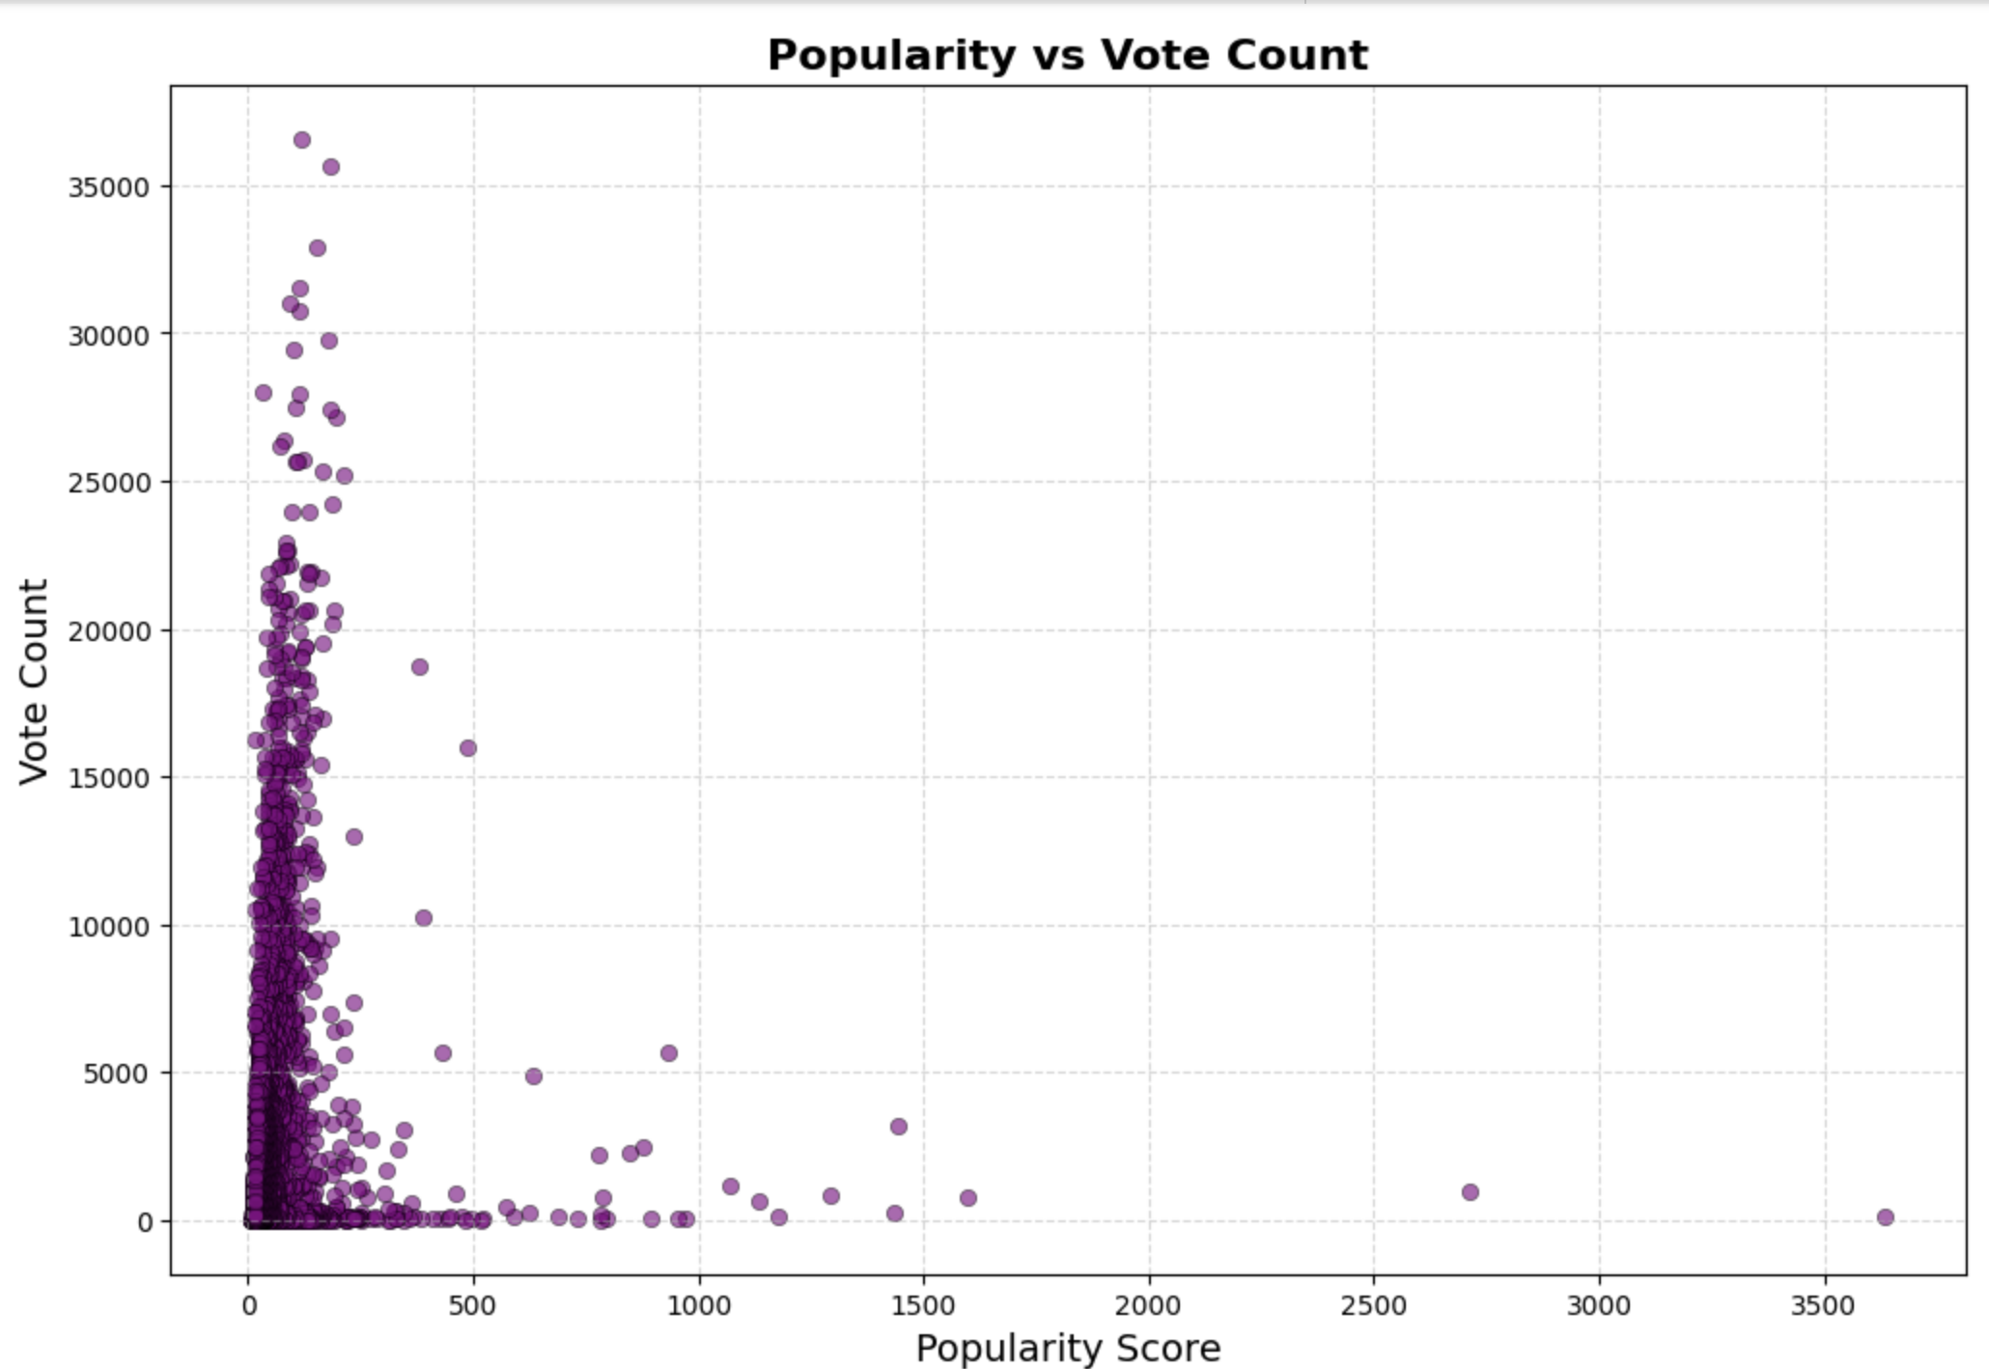
Data visualization
202288002 홀랑
3. Scatter Plot: Popularity vs Vote Count
There is a moderate correlation (0.15) between popularity and vote count. Let’s explore whether movies with higher popularity scores also attract more votes.

Slide 13
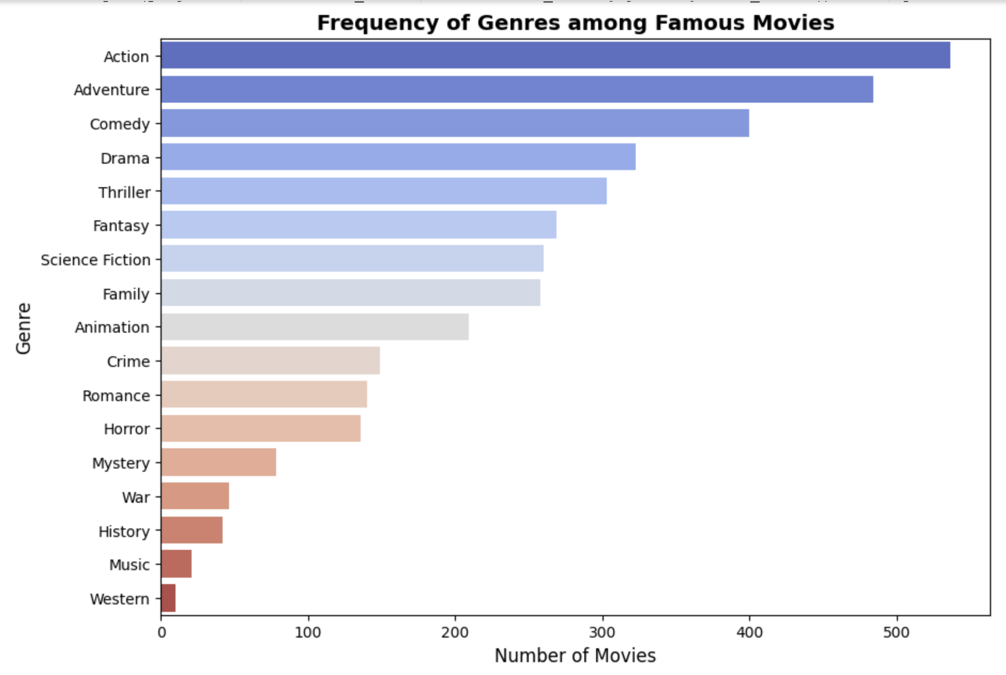
Data visualization
202288002 홀랑
4. Heatmap of Genre Popularity Among Famous Movies
Since 'genres' have been converted, let’s create a heatmap that shows which genres are most prevalent among famous movies. This visualization helps in understanding which genres have a higher likelihood of being popular and receiving a higher budget.

Slide 14
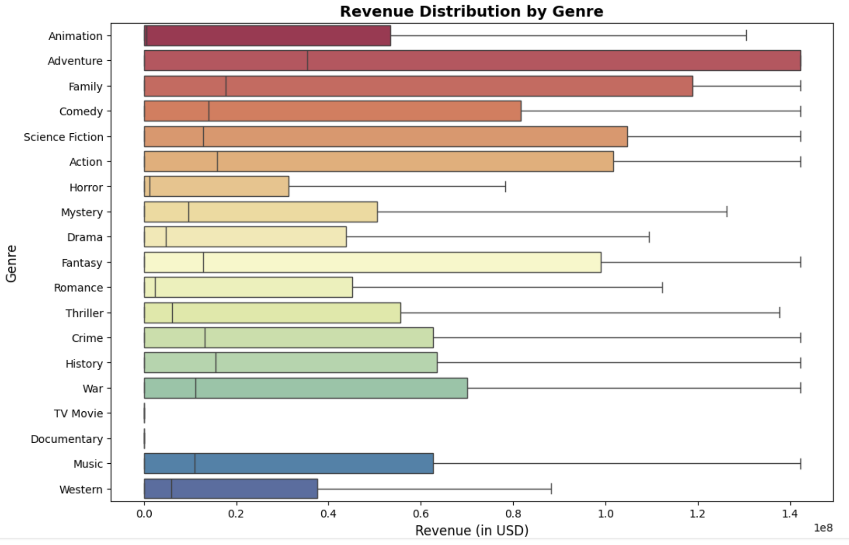
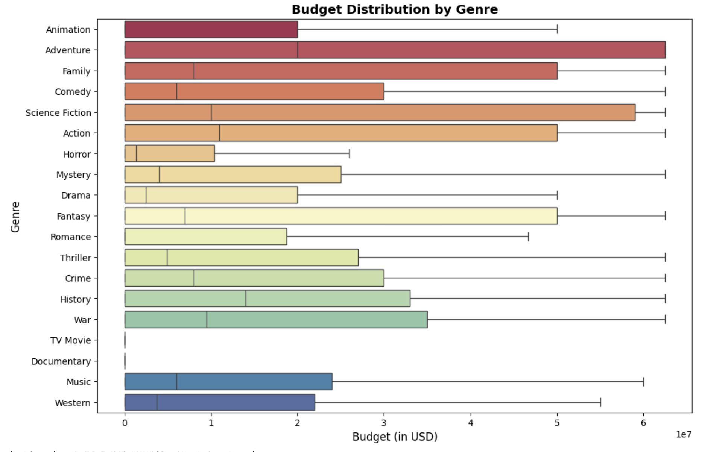
Data visualization
202288002 홀랑
5. Box Plot: Budget and Revenue Distribution by Genre
We can create a box plot to visualize the distribution of budget and revenue for different genres. This will help determine if certain genres consistently receive higher budgets or generate more revenue.

Slide 15
conclusion
202288002 홀랑
]
Which movie attributes contribute most to success?
High budgets, strong marketing campaigns, and genres like Drama, Action, and Adventure are key contributors to movie success.
Which genres are most common among successful movies?
Among the famous movies analyzed, Action, Drama, and Comedy were the most frequently successful genres.
How do budget and revenue relate to success?
Movies with higher budgets are more likely to have higher revenues, indicating a direct relationship between production investment and financial success.
What audience engagement metrics are most important?
Popularity and vote count are strong indicators of movie success, with "famous" movies generally having significantly higher audience engagement compared to average films.
How does the financial pattern differ by genre?
Genres such as Adventure and Science Fiction tend to have higher budgets and revenues, while Drama and Comedy often show more variation in financial returns.
THANK YOU

